Slide 1

Modelling the Diffusion Equation in 2-D (Cartesian)
Major Christopher Mihal
Air Force Institute of Technology
7 December, 2018

Slide 2
Overview
Problem Statement
Overview of the Diffusion Equation
Project Methodology
1-D
2-D
Select Python Code
Known issues
References
Project Data

Slide 3
Problem Statement
Write a 2-D Diffusion solver that has vacuum boundaries on the bottom and left faces and reflecting boundaries on the top and right boundaries
Include a solver README file, code, output file
Annotate known bugs in code and status of code

Slide 4


The Diffusion Equation
Solution for 1-D slab with vacuum boundaries:

Slide 5
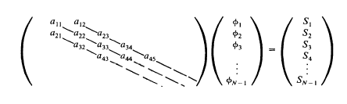

The Diffusion Equation
Approximating in 1-D

Slide 6
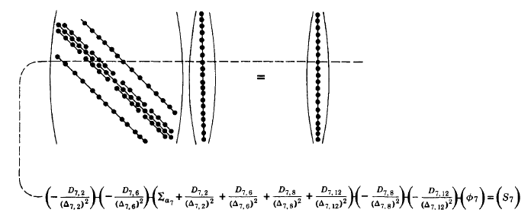
The Diffusion Equation
Approximating in 2-D

Slide 7
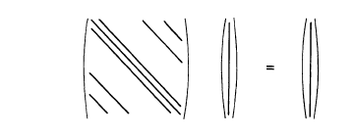

The Diffusion Equation
Approximating in 2-D

Slide 8
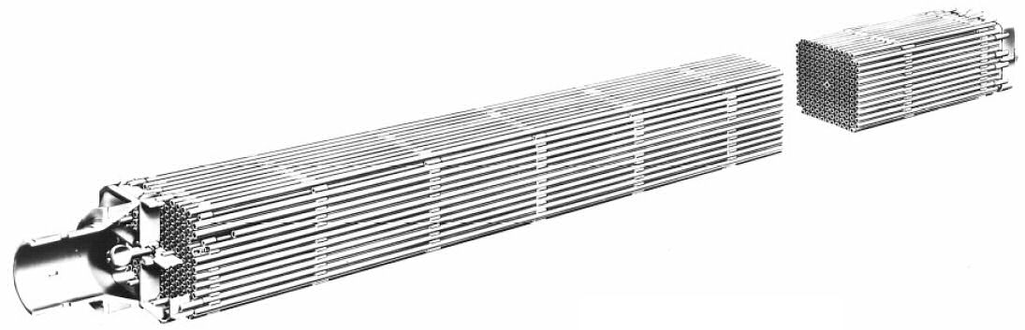
The Diffusion Equation
Why 2-D?
1-D assumes infinite y- and z-axis – not very realistic
2-D gives y-axis, but not z-axis, but this is closer to reality
Fuel pins are very long, so assuming infinity in the z-axis is adequate for certain approximations
More dimensions = better accuracy in the models

Slide 9
Project Methodology
Began by fully realizing problem in 1-D
Began with only vacuum boundaries
Added reflective boundaries
Expanded problem to 2-D
Attempted both Thomas Algorithm and Gauss-Seidel iterative solutions for 2-D
Learned far too late Thomas Algorithm only applies to 1-D, since there are no tri-diagonals in 2-D

Slide 10
Project Methodology
Planar source centered on y-axis
Assume Material homogeneity
Time-independent

Slide 11
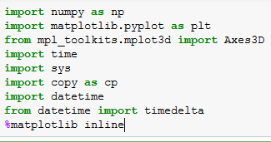
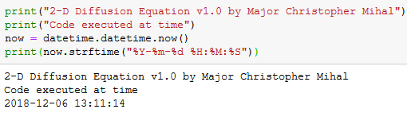
Select Python Code
Libraries referenced:
When code was run for future reference:

Slide 12
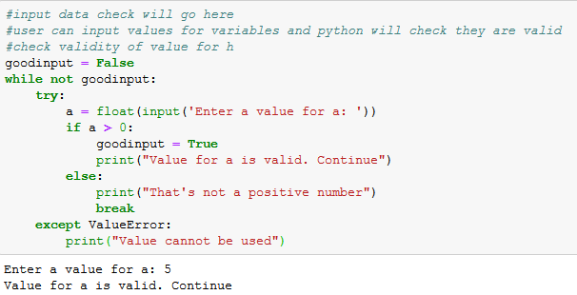
Select Python Code
User inputs for variables:

Slide 13
Parameters to Adjust
Parameter | Initial Value
N (number of cells) | 2/a*h + 1
a (size of geometry) | 5 cm
h (length of cell) | .1 cm
S (source) | 9 n/cm
∑a (cross section for absorption) | 0.2 cm
D (diffusion coefficient) | 1 cm
L^2 | D/∑a cm

Slide 14
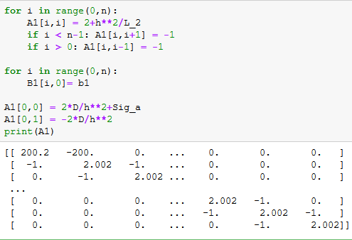
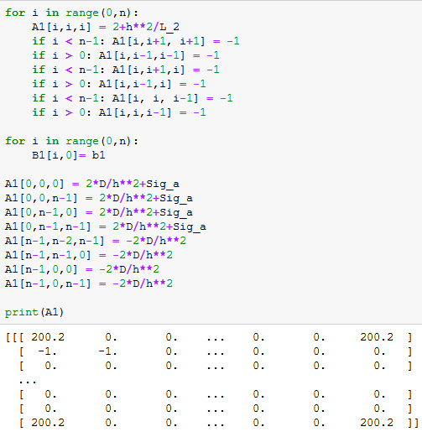
Select Python Code
Define matrices (1-D and 2-D):

Slide 15
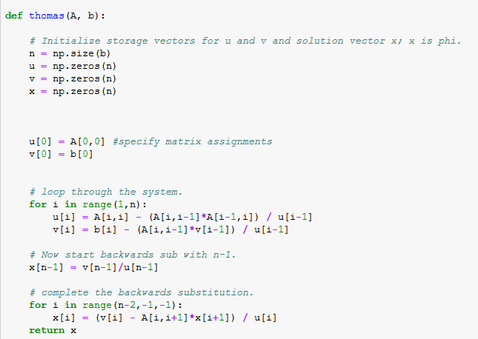
Select Python Code
Use Thomas Algorithm for approximation in 1-D:

Slide 16
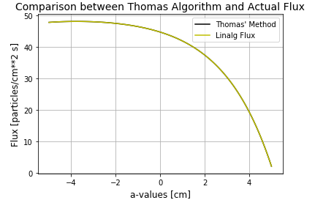
Select Python Code
1-D Outputs:

Slide 17
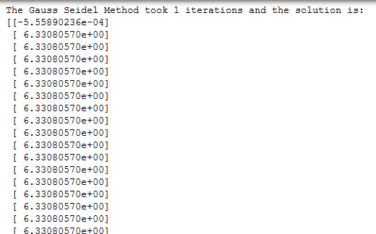
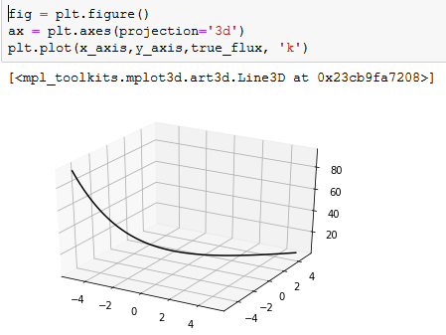
Known Bugs
Gauss-Seidel runs in 2-D, but returns incorrect values that I cannot plot, as seen below (True Flux on right)
Cryptic error message: “ValueError: input operand has more dimensions than allowed by the axis remapping”

Slide 18
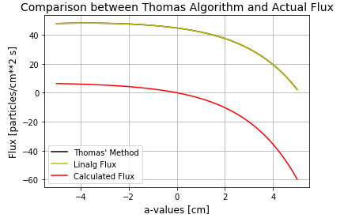
Known Bugs
True Flux (calculated flux) equation in 1-D has correct slope, but values are incorrect, as shown below:

Slide 19
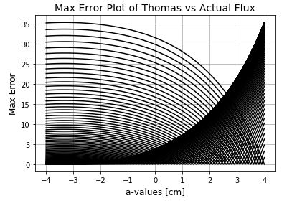
Project Data
Number of “invalid syntax” errors throughout duration: 74
Number of times I had to clear the Kernel: 44
Number of times I deleted entire code accidentally: 1
Number of nightmares involving Python: 2
Number of visits to Stackoverflow: approaching infinity
Favorite inexplicable plotting error (since been fixed):

Slide 20
Summary
What is the diffusion equation?
Modelling the diffusion equation in 2-D vs 1-D
Methodology I chose
Challenges I faced - Code compiles, but bugs in the underlying equations
Future work

Slide 21
References/Acknowledgements
[1] James J. Duderstadt and Louis J. Hamilton, Nuclear Reactor Analysis, John Wiley and Sons, Inc., New York, NY, 1976. pp. 124-200.
[2] Ryan McClarren, Computational Nuclear Engineering and Radiological Science Using Python, Academic Press, Notre Dame, IN, 2018. pp. 350-360.
[3] David Bodansky, Nuclear Energy Principles, Practices and Prospects, Springer Science+Business Media, Seattle, WA, 2004. pp153-168.
[4] Jake VanderPlas, Python Data Science Handbook, O’Reilly Media, 2016. Accessed via https://jakevdp.github.io/PythonDataScienceHandbook/04.12-three-dimensional-plotting.html
[5] LTC Hobbs, AFIT ENP Instructor – numerous in-person conversations, guidance, and pointing
me to use Duderstadt
[6] Capt Bevins, AFIT ENP Instructor – throughout

Slide 22
Questions?

